Slide 1
Advaced Analytics with TIBCO Spotfire
Information Links and Data Connectors

Slide 2
Bringing Data in Spotfire
Direct file access
Data connections via connectors
Information Links

Slide 3
In-memory vs in-database analytics
When data is loaded into the in-memory data engine, an entire copy is loaded in your computer/server.
Spotfire‘s in-memory data engine is highly optimized for working with datasets of all sizes, but eventually you do run out of memory.
This engine compresses data, removes redundant columns and swaps data to disk if needed.

Slide 4
In-memory vs in-database analytics (II)
Loading all data in-memory might not be feasible, nor needed.
Spotfire can instead query the database, extract the data it needs and only keep the aggregated/transformed data required for the chart.
To handle this, Spotfire uses data-on-demand, which that data is retrieved only when something changes.

Slide 5
Information Links
Information Links are Spotfire‘s database abstraction method. They specify references to:
Columns
Join elements
Filter elements
Can be personalized or parameterized.
Support for joins between multiple tables (across databases), stored procedures, custom SQL and write back to DB.
They support only in-memory data.

Slide 6
Information Link vs Data Connectors
With Information Links the data will be in memory, not external.
Connecting to an external data source (e.g. Teradata) would require that all clients have the driver. With information links, you only need the JDBC.

Slide 7
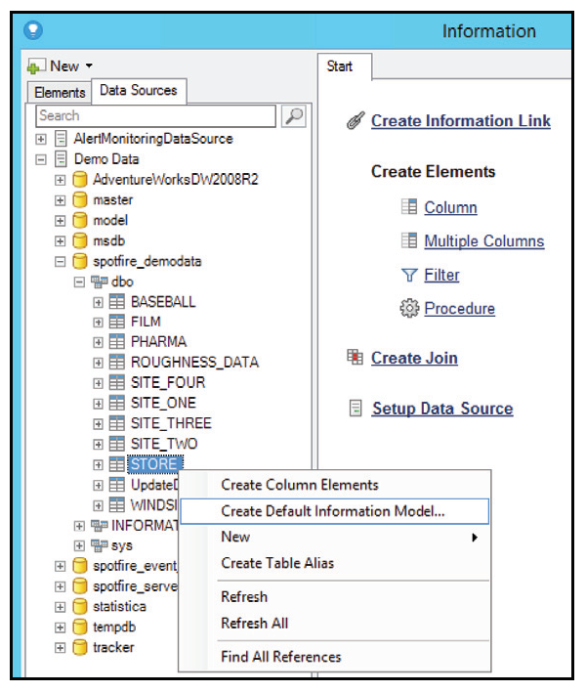
To create an Information Link
Connect to a data source.
Create a default information model (see screenshot)
To define or manage information links, the Information Designer can be found under the Data menu.
➔ Create Connector

Slide 8
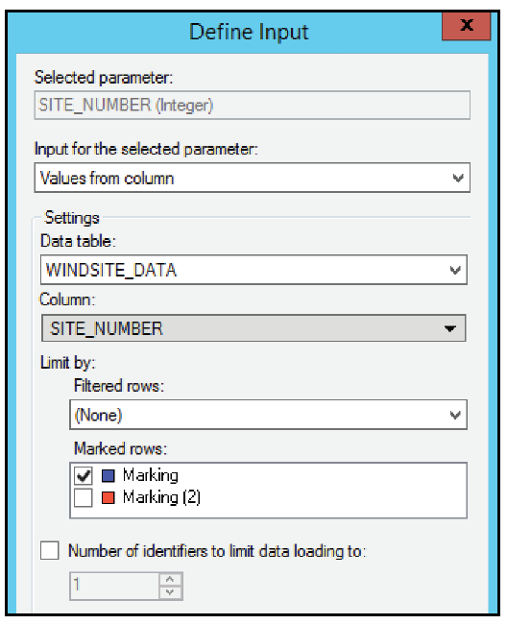
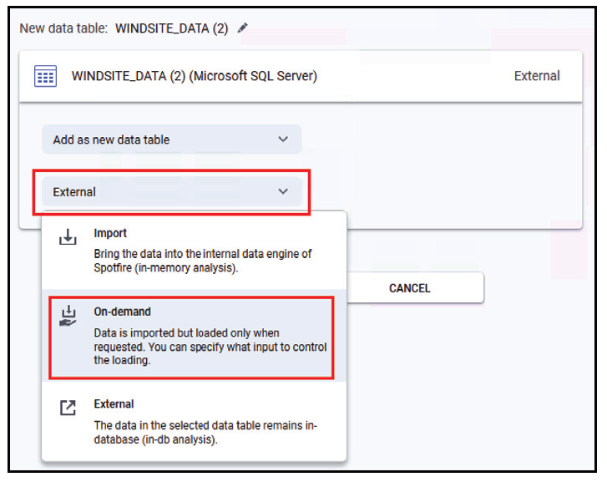
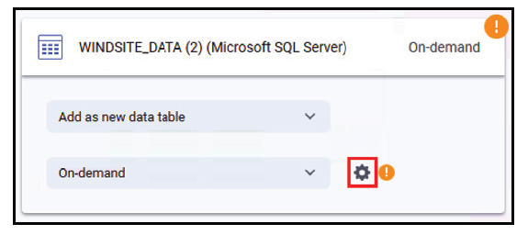
Data On-Demand
Data snapshots will be reloaded as needed.
While setting the connection, you can choose data to be on-demand.

Slide 9
Custom Expressions
Custom Expressions can be used, but there are limitations depending on the connector.
In general, we can perform custom expressions within visualizations, not on calculated columns.

Slide 10
Important points when working with external data
Recommendations engine does not work.
Filters are not created by default.
Box plots cannot be used on external data.
Spotfire‘s Transformations cannot be used on external data.
Only the data source‘s functions for calculated column expressions can be used.

Slide 11
Limiting what data to load
Method | Use when? | Define where?
On-demand data table | When data should dynamically change with a predefined condition, for example, through a marking/filtering action. | On-demand data tables are added to your analysis in TIBCO Spotfire by selecting an information link or a data table from a data connection in the Files and data flyout, and then selecting the On-demand option from the drop-down list in the summary view. You must also specify the input conditions that should control loading in the On-Demand Settings dialog.
Details visualizations against external sources | When you are analyzing in-database data using a connection to an external data source you only load the requested data. By setting up visualizations based on the in-db data as details visualizations limited by the marking or filtering in a master visualization you can make sure that the actual loaded data is limited to a subsection of the available data only. | Make sure that the master data table and the in-db data table have at least one column in common so you get a column match. Right-click on the master visualization and select Create Details Visualization. Set up the new details visualization to use the in-db data table.

Slide 12
Limiting what data to load
Method | Use when? | Define where?
Prompted and/or Parameterized Data Connections | When the source data amount is huge, but the end users of the data connection are allowed to determine what data to analyze themselves. Parameters defined in the data source can be configured as end user prompts. When you want to keep the data in the external data source (but data connections can also be used to import data). | Prompts are defined in the Views in Connection dialog or, for SAP BW BEx query connections, in the Data Selection in Connection dialog, as a part of configuring the data connection. Click Define Prompting and specify which column or parameter to prompt for. Mandatory parameters are automatically added as prompts.
Prompted Information Links | When the source data amount is huge, but the end users of the information link are allowed to determine what data to bring in for analysis themselves. Information links are always analyzed in-memory. Can in some cases be replaced by an on-demand data table. | Prompts are defined in Information Designer, Information Link tab, Prompts section.

Slide 13
Limiting what data to load
Method | Use when? | Define where?
Personalized Information Links | When you want the data source to return only information applicable for a certain user name (via a lookup table) or for a specified group or user domain. | Personalized information links are set up on a filter or column element in Information Designer using the %CURRENT_USER%, %CURRENT_GROUPS% or %CURRENT_USER_DOMAIN% syntax. See Personalized Information Links for more information.
Parameterized Information Links | When you want the data source to return only information applicable for a certain user or group in a more flexible way than with personalized information links. | Parameters are created in Information Designer (for example, as a part of an expression set on a column or filter) but their properties and definitions are defined using the API. By using a parameterized information link and a configuration block, it is possible to create an analysis with different input parameters (e.g., to be used by an On-Demand data table) for different groups of users. See Parameterized Information Links for more information.

Slide 14
Caching in Spotfire

Slide 15
Why caching?
Caching is storing data in RAM or hard disk for performance.
It helps to
Avoid hitting database every time anyone opens the analysis.
Eliminate wait time.
Common use case:
When many dashboards require data from the same Information Link.

Slide 16
How it works?
Individual Information Links are cached at the Spotfire Server level.
The cache is a Spotfire-specific Binary file stored on the hard drive of Spotfire Server.
The cache is self-cleaning depending on timeouts and validation query. A server restart will also clear it up.

Slide 17
Creating cache
First user takes the hit.
Automation Services and fixed schedules: schedule a job that opens a file (which will trigger the Information Link).
Automation Services and triggers: Run a bat file programatically or call Automation Services webservices to wait for instance for an ETL process to finish.
Scheduled Updates. In this case cache is retained in RAM.

Slide 18
Considerations
Enough disk space should be available.
To use the benefits of caching, at least one report should have the Information Link completely loaded. Subsequent reports using the cache should be triggered with enough time in between.

Slide 19
Considerations II
Caching does not exempt you from good practices like data on-demand and in-database analytics. Spotfire allows for building great hybrid solutions, but does not do miracles.
Caching 15 queries at the same time may not be as fast as 3x5. This is environment-specific, so one should try different things.

Slide 20
Considerations III
Scheduled Updates will reduce load time in the Web Player, but not in the Analyst Client.
Saving an analysis as embedded (dxp) or data (sbdf) may not be an option if this is larger than 2GB and the application database is a Microsoft SQL Server.

Slide 21
Considerations IV
Information Link caching option is not useable in clustered TIBCO Spotfire Servers, because caching needs to happen in each server (not shared across servers). To create cache in each server, then the dashboard needs to connect through Spotfire Analyst to each server.
Attachment Manager has a default cache expiration of 1 day, and a default cache size of 10 GB.

Slide 22
Considerations V
Multiple dashboards using same Information link should not be run at the same time otherwise all the dashboards will try to cache the same Information link multiple times.
If data volume retrieved by that Information link is huge, disk space can also be exhausted and it will also impact your database performance as same query is running multiple times simultaneously.

Slide 23
Performance Improvement
Use Scheduled Updates on the web player to pre-load the analysis.
Keep data in the database instead of loading it into memory. Spotfire passes the aggregations to the database, which means less data needs to be transferred to Spotfire
Use automation services to pre-load the file with data and save it to the Spotfire library with the data embedded.

Slide 24
Examples from caching - Docs
Creating a scheduled update by using Spotfire Server
Caching data with TIBCO Spotfire® Automation Services
Caching data through Information Links

Slide 25
References
Spotfire Analyst User‘s Guide
How to find the SQL query Spotfire sends to a database?
Caching calculated columns
Trace DXPs connected to an information link
[Video] Setting up and optimizing information links
[Video] Caching in TIBCO Spotfire

